Slide 1

SEMTIMENTS ANALYSIS: TWITTER ON CLIMATE CHANGE

Slide 2
TEAM 10: ADVANCE CLASSIFICATION PRESENTATION
Facilitator : Jamie Snyders
Team Leader : Kwanda Mazibuko
Members : Lucy Lushaba
: Casper Kruger
: Gudani Mbedzi

Slide 3
PROJECT PROCESS
1
2
1
2
3
1
2
3
5
2
3
4
5
4
5
2
4
2
Data Processing and Engineering
Exploratory Data Analysis
Model Building
Model Performance and Deployment
Conclusion

Slide 4
PROBLEM STATEMENT
The developments around global warming and the increase use of social media has forced companies to design products and services around lessen the impact on the environment and the sentiments expressed by their target market on social media platform. Therefore it is important that methods such as sentimental analysis are explored to provide companies with solutions that can provide insights for future marketing strategies thus increasing company profit margins.

Slide 5
Data Processing and Engineering

Slide 6
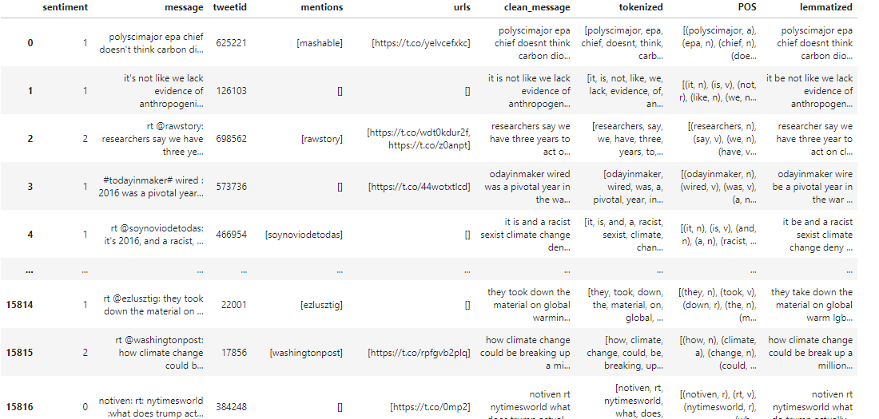
Copy the data frame and rename the class labels for better data visualization
Extract hashtags and store them in separate data frames for each class
Remove 'noisy entities' such as URL's, punctuations, mentions, numbers and extra white space.
Tokenization
Perform part of speech tagging (POS) and lemmatization
Create data frames to store the top 25 words and their respective frequencies in each class
Specific named entity extraction

Slide 7
Exploratory Data Analysis (EDA)

Slide 8
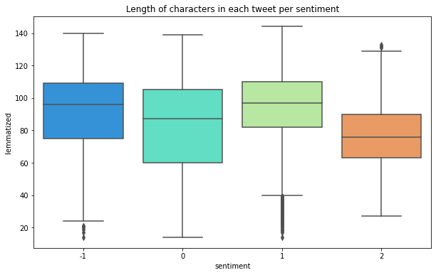
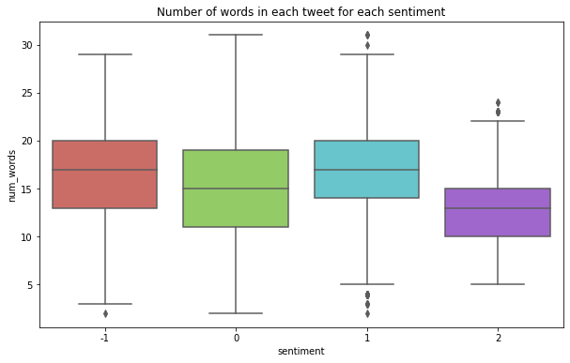
Box-plot for the length of characteristics in each tweet per sentiment
Box-plot for the number of words in each tweet per sentiment

Slide 9
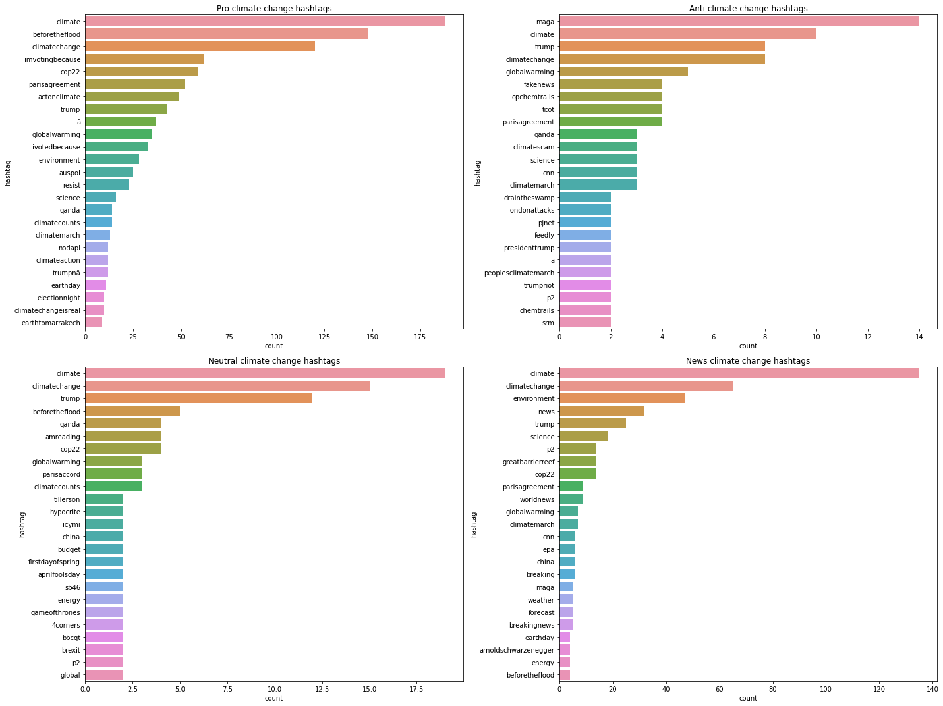
Bar-plot across all 4 classes for the climate change hashtags

Slide 10
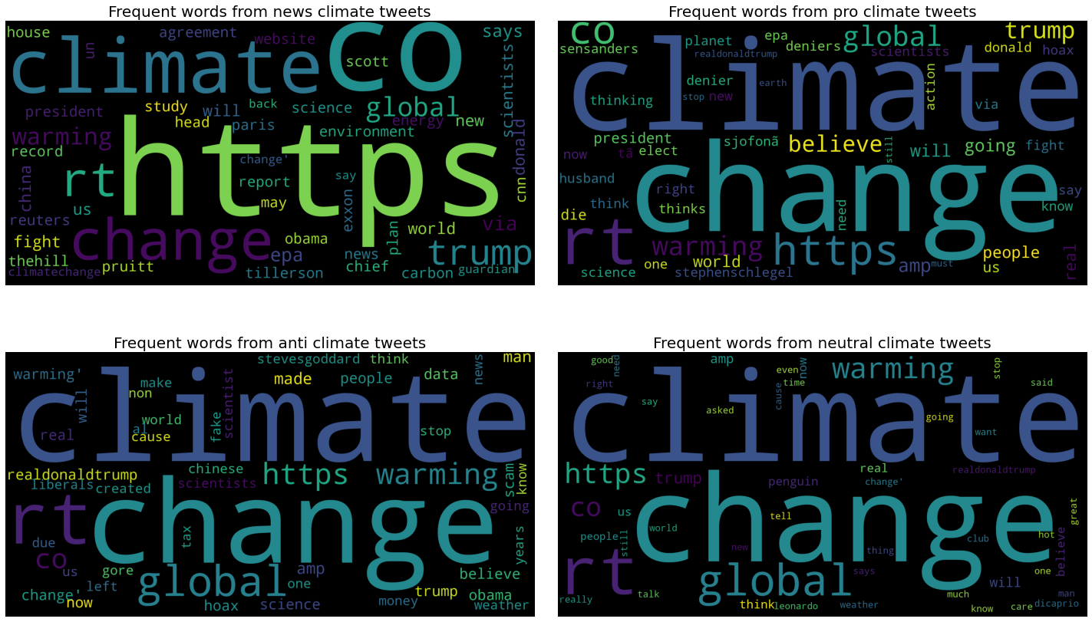
The most frequent words across all 4 classes of climate change tweets

Slide 11
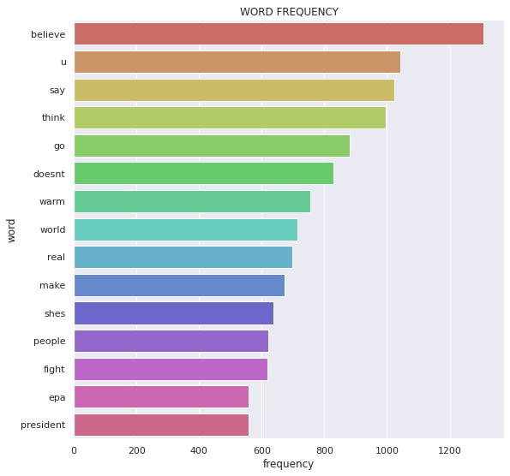
Bar-plot for the frequent words with common words

Slide 12
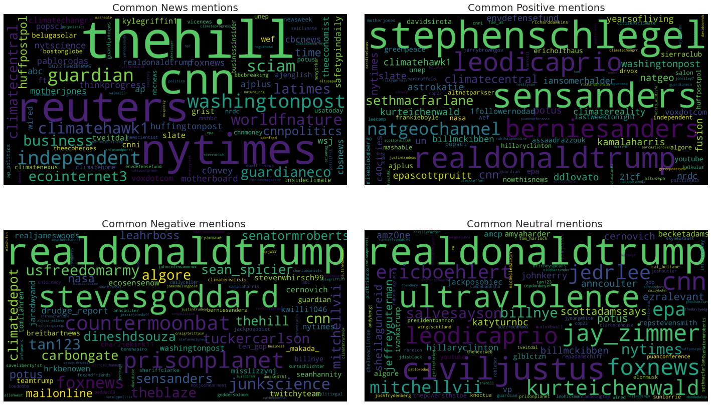
Common news mentions across all 4 classes

Slide 13
Model Building And Performance Evaluation

Slide 14
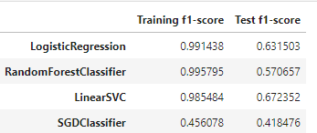
Summary of the f1-score
The best model has to the Linear SVC, as it has the highest test f1 score of 0.7

Slide 15
Conclusion
Based on the tweets that we explore, 54% belonged to the pro climate change class, which brings us to the conclusion that majority of the user's belief that climate change is man-made. It was observed that most of the tweets contained the words climate change & trump across all classes. There is also an indication that there was a massive amount of information that resonated with users and was shared with a broader audience, this is based on the of retweets present across all classes.
The Linear Support Vector Machine model performed better on unseen data. The F1-score or F1-measure is a measure of a model's accuracy in test data set. The model has a score more than 0.7 on unseen data (Kaggle leaderboard submission).

Slide 16
Thanks! Any question?

